Slide 1
REST - RESTful API

Slide 2
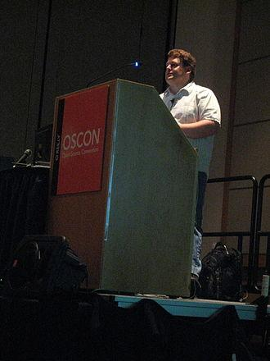
History
The term representational state transfer was introduced and defined in 2000 by Roy Fielding in his doctoral dissertation

Slide 3
What is API?
“An API for a website is code that allows two software programs to communicate with each other.”

Slide 4
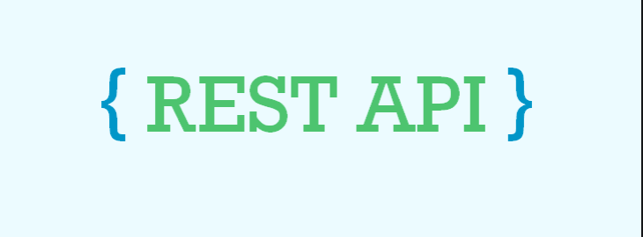


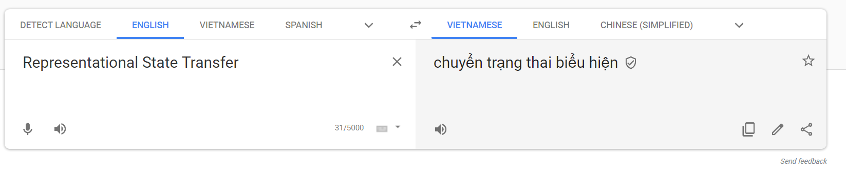
REST
(noun)
REpresentational State Transfer
Tip
Don’t wait till the end of the presentation to give the bottom line.
Reveal your product or idea (in this case a translation app) up front.
It means when a RESTful API is called, the server will transfer to the client a representation of the state of the requested resource.

Slide 5
REST & RESTful
REST (noun)
Is a style of software architecture
RESTful (adj)
refer to web services implementing that architecture.

Slide 6
Resource & Representations
Key terms:

Slide 7
Resource
Any information that can be named can be a resource
A document, a post, collection of other resources, ...

Slide 8
Representations
The state of the resource is representations.
Examples:
Resource: post
Service: get information (GET)
Representations:
Title, like, share, comments
Json, XML , HTML Format

Slide 9
REST Constraints
Client-server
Separating the user interface concerns from the data storage concerns
Connect with each others by uniform interface
2. State-less
Each request from client to server must contain all of the information necessary to understand the request (Self-descriptive messages)
Server contains no client state

Slide 10
REST Constraints
3. Cacheable
Server response (representations) are cacheable
4. Uniform interface
Defines the interface between client and server

Slide 11
4. Uniform Interface
Defines the interface between client and server
Identification of resources (URI)
Examples:
HTTP Verbs action on resource (GET, PUT, POST, DELETE)
URIs (resource name)
HTTP Response (status,body)
Hypermedia as the engine of application state (HATEOAS)
Hyperlinks that server return within response that can help user change state or link to other resources.

Slide 12


4. Uniform Interface
GET
POST
PUT
DELETE
HTTPS://someplace.com/posts
Status: 200
Body:
Name: ‘Tích cực thăm ngàn’,
Like: 1
….

Slide 13
REST Constraints
5. Layered System
Client doesn’t know what behind the scenes.
6. Code on demand
Optional

Slide 14
Rules for URI
(Identify Resources)

Slide 15

No (/) at the end

Slide 16
2. (/) to indicate a hierarchical relationship
http://facebook.com/my-name/photos

Slide 17
3. Hyphens (-) should be used to improve the readability of URIs
http://facebook.com/my-name/photos

Slide 18
4. No underscore (_)
http://facebook.com/my-name/photos

Slide 19
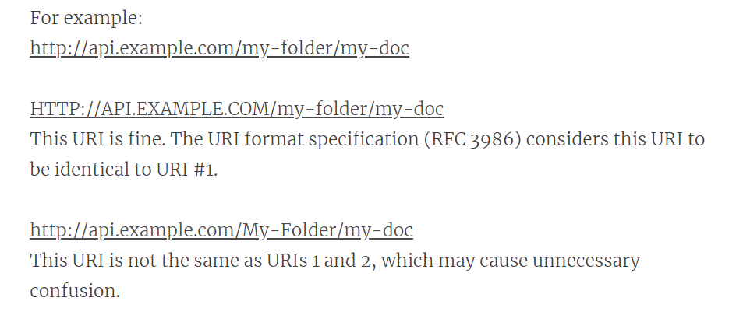
5. Lowercase letters
http://facebook.com/my-name/photos

Slide 20
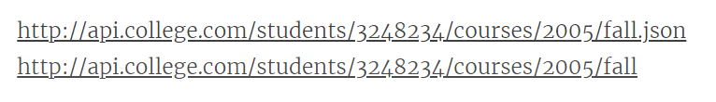
6.No file extensions
http://facebook.com/my-name/photos/hinh-chup-voi-ban-gai.png
Use Content-Type

Slide 21
7.Plurals or singular
http://facebook.com/my-name/photos
http://facebook.com/my-name/photos/123
Or
http://facebook.com/my-name/photo
http://facebook.com/my-name/photo/123

Slide 22
8. Use HTTP Method
GET|PUT|DELETE http://www.example.com/products/66432
No
GET http://api.example.com/services?op=update_customer&id=12345&format=json

Slide 23
Ref:
https://pepa.holla.cz/wp-content/uploads/2016/01/REST-API-Design-Rulebook.pdf
https://restfulapi.net/rest-architectural-constraints/
https://www.restapitutorial.com/lessons/restfulresourcenaming.html
https://medium.com/extend/what-is-rest-a-simple-explanation-for-beginners-part-2-rest-constraints-129a4b69a582
https://cloud.google.com/apis/design/design_patterns

Slide 24
Thanks for listening
Give me any question!!!

